Slide 1
ALU Design Example (1-bit & 4-bit)
Protik Chakroborty Lecturer CSE, VU

Slide 2
ALU in CPU
Program Counter will have address of next instruction to be executed in current clock cycle.
Address in PC will be sent to RAM to retrieve instruction.
Instruction will be decoded by control unit and will select registers and/or immediate values.
Data within registers and/or immediate values will be sent to Arithmetic and Logic Unit (ALU) to perform operations.
The ALU will perform operation and result will be sent to the register to be written.
Finally, PC will be incremented to point to the next instruction in next clock cycle.
Program Counter (PC)
d [3]
a[1] _{d [2]}
a[0] _{d [1]}
op [1]
op [0]
op_sel[1] op_sel[0]
i[1] o[1]
i[0] o[0]
PC
d [0]
RAM
(Main
Control Unit (CU)
+1
Memory)
Register File
Ra Rb
alu[1]alu[0]
a
a
Wr Wrd
r
ADD R1, R0
b
b
clk
Arithmetic and Logic Unit (ALU)
Figure: 1-bit CPU

Slide 3

ALU in CPU
Program Counter will have address of next instruction to be executed in current clock cycle.
Address in PC will be sent to RAM to retrieve instruction.
Instruction will be decoded by control unit and will select registers and/or immediate values.
Data within registers and/or immediate values will be sent to Arithmetic and Logic Unit (ALU) to perform operations.
The ALU will perform operation and result will be sent to the register to be written.
Finally, PC will be incremented to point to the next instruction in next clock cycle.
Program Counter (PC)
d [3]
a[1] _{d [2]}
a[0] _{d [1]}
op [1]
op [0]
op_sel[1] op_sel[0]
i[1] o[1]
i[0] o[0]
PC
d [0]
RAM
(Main
Control Unit (CU)
+1
Memory)
Register File
alu[1]
alu[0]
Ra Rb
a
a
Wr
Wrd
r
b
b
clk
Arithmetic
and Logic
Un^{S}it (ALU)
Figure: 1-bit CPU

Slide 4
ALU Basics

Slide 5
ALU
Arithmetic Logic Unit (ALU) is a combinational digital circuit that performs arithmetic and bitwise operations on integer binary numbers. It is a fundamental building block of Central Processing Unit (CPU) of computers.
The inputs to an ALU are the data to be operated on, called operands, and a code indicating the operation to be performed. The ALU's output is the result of the performed operation.
In many designs, the ALU also has status/FLAG inputs or outputs, or both, which convey information about a previous operation or the current operation, respectively, between the ALU and external status/FLAG registers.

Slide 6
Functions of ALU
a. Arithmetic operations:
Add: A and B are summed and the sum appears at Y and carry-out.
Add with carry: A, B and carry-in are summed and the sum appears at Y
and carry-out.
Subtract: B is subtracted from A (or vice versa) and the difference appears at Y and carry-out. For this function, carry-out is effectively a "borrow" indicator. This operation may also be used to compare the magnitudes of A and B; in such cases the Y output may be ignored by the processor, which is only interested in the status bits (particularly zero and negative) that result from the operation.
Subtract with borrow: B is subtracted from A (or vice versa) with borrow (carry-in) and the difference appears at Y and carry-out (borrow out).
Two's complement (negate): A (or B) is subtracted from zero and the difference appears at Y.
Increment: A (or B) is increased by one and the resulting value appears at Y.
Decrement: A (or B) is decreased by one and the resulting value appears at Y.

Slide 7
Functions of ALU
Bitwise logical operations:
AND: the bitwise AND of A and B appears at Y.
OR: the bitwise OR of A and B appears at Y.
Exclusive-OR: the bitwise XOR of A and B appears at Y.
Ones' complement: all bits of A (or B) are inverted and appear at Y.
Bit shift operations: ALU shift operations cause operand A (or B) to shift left or right (depending on the opcode) and the shifted operand appears at Y.
Arithmetic shift: The operand is treated as a two's complement integer,
meaning that the most significant bit is a "sign" bit and is preserved.
Logical shift: A logic zero is shifted into the operand. This is used to shift unsigned integers.
Rotate: The operand is treated as a circular buffer of bits so its least and most significant bits are effectively adjacent.
Rotate through carry: The carry bit and operand are collectively treated as a circular buffer of bits.

Slide 8
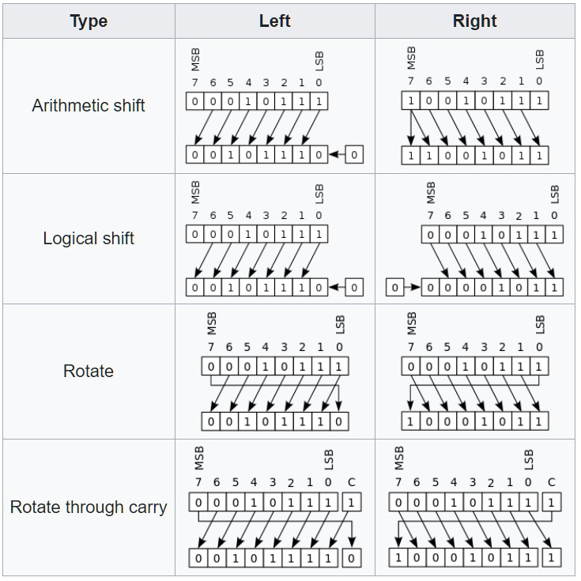
Functions of ALU

Slide 9
FPU
A floating-point unit (FPU, colloquially a math coprocessor) is a part of a computer system specially designed to carry out operations on floating-point numbers. Typical operations are addition, subtraction, multiplication, division, and square root.
In general-purpose computer architectures, one or more FPUs may be integrated as execution units within the Central Processing Unit (CPU). However, many embedded processors/microcontrollers do not have hardware support for floating-point operations.
When a CPU is executing a program that calls for a floating-point operation, there are three ways to carry it out:
A floating-point unit emulator (A floating-point library/Software).
Add-on FPU (Coprocessor/Not inside Processor).
Integrated FPU (Inside Processor).

Slide 10
Example 1: 1-bit ALU design
𝑺_{𝟏}

Slide 11

1-bit AND gate
𝐀
A
AND
𝐀𝐁
O
𝐁
B

Slide 12

1-bit OR gate
𝐀
OR
A
𝐀 + 𝐁
O
B
𝐁

Slide 13

1-bit XOR gate
A
XOR
𝐀
𝐀⨁𝐁
O
B
𝐁

Slide 14
1-bit Adder
A | B | Cin | Cout | S
0 | 0 | 0 | 0 | 0
0 | 0 | 1 | 0 | 1
0 | 1 | 0 | 0 | 1
0 | 1 | 1 | 1 | 0
1 | 0 | 0 | 0 | 1
1 | 0 | 1 | 1 | 0
1 | 1 | 0 | 1 | 0
1 | 1 | 1 | 1 | 1
A
B
Cin
FA
S
S = A B Cin+ A B Cin+ A B Cin + A B Cin
Cout
+ B
Cout = A B + A C C

Slide 15

1-bit Subtractor
B
Cin =1
B
A
A
B
FA
FA
Cin
Cin=1
Cout
S
C
S

Slide 16
1-bit Adder (Modified)
B
Cin=0
A
B
FA
Cin=0
C
S

Slide 17
1-bit Adder/Subtractor
B
Cin/Sel
A
B
A B
Sel
ADD/SUB
S
FA
S

Slide 18
1-bit Multiplier
𝐀
𝐁 𝐌
𝐀
𝟎 ∗ 𝟎 = 𝟎
𝟎 ∗ 𝟏 = 𝟎
𝟏 ∗ 𝟎 = 𝟎
𝟏 ∗ 𝟏 = 𝟏
𝐀𝐁
𝐁
A
MUL
O
B

Slide 19
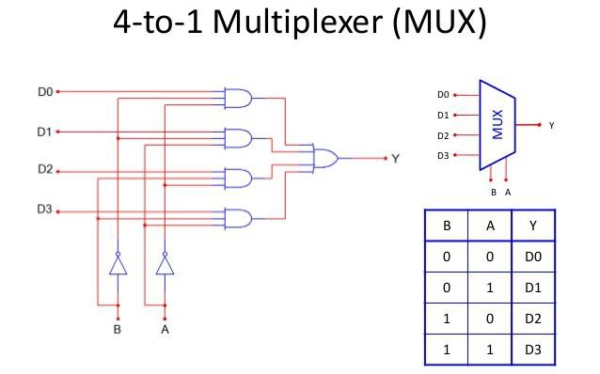
1-bit Shifter
𝐘 = 𝐀^{ഥ}. 𝐁^{ഥ}. 𝐃𝟎 + 𝐀^{ഥ}. 𝐁. 𝐃𝟏 + 𝐀. 𝐁^{ഥ}. 𝐃𝟐 + 𝐀. 𝐁. 𝐃𝟑

Slide 20


1-bit Shifter
A
𝑺_{𝟏} | 𝑺_{𝟐} | Output | Operation
0 | 0 | A | No Shift
0 | 1 | 0 | Left Shift
1 | 0 | 0 | Right Shift
1 | 1 | X | X
X
0 0
𝟑 𝟐 𝟏 𝟎
4 to 1 MUX
Input: A
Right shift: 0A Left shift: A0
Input: 1
Right shift: 01
Left shift: 10
O

Slide 21


1-bit Shifter
A
X
0 0
A
𝑺_{𝟏}
𝑺_{𝟐}
SHIFT
𝟑 𝟐 𝟏 𝟎
4 to 1 MUX
O
𝑺_{𝟏} | 𝑺_{𝟐} | Output | Operation
0 | 0 | A | No Shift
0 | 1 | 0 | Left Shift
1 | 0 | 0 | Right Shift
1 | 1 | X | X
O

Slide 22
All the circuits so far
A B
A B
A B
AND
OR
XOR
O
O
O
A B
Sel
ADD/SUB
A B
MUL
SHIFT
A
𝐒_{𝟐}
𝐒_{𝟏}
O
O
S
If 𝐬𝐞𝐥 = 𝟎, 𝐒 = 𝐀𝐃𝐃
If 𝐬𝐞𝐥 = 𝟏, 𝐒 = 𝐒𝐔𝐁
If 𝐒_{𝟏} = 𝟎, 𝐒_{𝟎} = 𝟏, 𝐒 = 𝐋𝐄𝐅𝐓 𝐒𝐇𝐈𝐅𝐓
If 𝐒_{𝟏} = 𝟏, 𝐒_{𝟎} = 𝟎, 𝐒 = 𝐑𝐈𝐆𝐇𝐓 𝐒𝐇𝐈𝐅𝐓

Slide 23
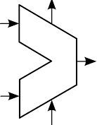
ALU Circuit
S
A
O
B
S

Slide 24
1-bit CPU
Program Counter (PC)
d [3]
a[1]
op [1]
op [0]
op_sel[1] op_sel[0]
i[1] o[1]
i[0] o[0]
PC
d [2]
a[0] _{d [1]}
d [0]
RAM
(Main
Control Unit (CU)
+1
Memory)
Register File
alu[1]
alu[0]
Ra Rb
a
a
Wr Wrd
r
b
b
clk
Arithmetic and Logic Unit (ALU)
S
Figure: 1-bit CPU

Slide 25
ALU Circuit
Available Operations: ADD,
SUB, MUL, AND, OR, XOR,
LEFT SHIFT, RIGHT SHIFT
All operations will
be executed at the same.
Only one operation must be selected by Control Unit.
Total Operations: 8
S
A
R
B
S

Slide 26
1-bit ALU Circuit
Available Operations: ADD,
SUB, MUL, AND, OR, XOR,
𝐒_{𝟐}
𝐒_{𝟏}
𝐒_{𝟎}
A
R
LEFT SHIFT, RIGHT SHIFT
Total Operations: 8
So, selection line must support at least 8 combinations.
B
S

Slide 27
1-bit ALU Circuit
𝐒_{𝟐}
𝐒_{𝟏}
𝐒_{𝟎}
We will need a MUX to select our expected output.
A
As there are eight operations in total, we will use 8 to 1 MUX
R
B
S

Slide 28
1-bit ALU Circuit
8 to 1 MUX
𝐒_{𝟐} 𝐒_{𝟏} 𝐒_{𝟎}
𝐈_{𝟎}
0
1
2
3
4
5
6
7
𝐒_{𝟐} | 𝐒_{𝟏} | 𝐒_{𝟎} | 𝐘
0 | 0 | 0 | 𝐈_{𝟎}
0 | 0 | 1 | 𝐈_{𝟏}
0 | 1 | 0 | 𝐈_{𝟐}
0 | 1 | 1 | 𝐈_{𝟑}
1 | 0 | 0 | 𝐈_{𝟒}
1 | 0 | 1 | 𝐈_{𝟓}
1 | 1 | 0 | 𝐈_{𝟔}
1 | 1 | 1 | 𝐈_{𝟕}
𝐈_{𝟏}
𝐈_{𝟐}
𝐈_{𝟑}
Y
𝐈_{𝟒}
𝐈_{𝟓}
𝐈_{𝟔}
𝐈_{𝟕}
𝐘 = 𝐒_{𝟐}. 𝐒_{𝟏}. 𝐒_{𝟎}. 𝐈_{𝟎} + 𝐒_{𝟐}. 𝐒_{𝟏}. 𝐒_{𝟎}. 𝐈_{𝟏} + 𝐒_{𝟐}. 𝐒_{𝟏}. 𝐒_{𝟎}. 𝐈_{𝟐} + 𝐒_{𝟐}. 𝐒_{𝟏}. 𝐒_{𝟎}. 𝐈_{𝟑} +
𝐒_{𝟐}. 𝐒_{𝟏}. 𝐒_{𝟎}. 𝐈_{𝟒} + 𝐒_{𝟐}. 𝐒_{𝟏}. 𝐒_{𝟎}. 𝐈_{𝟓} + 𝐒_{𝟐}. 𝐒_{𝟏}. 𝐒_{𝟎}. 𝐈_{𝟔} + 𝐒_{𝟐}. 𝐒_{𝟏}. 𝐒_{𝟎}. 𝐈_{𝟕}

Slide 29
1-bit ALU Circuit
𝐒_{𝟐} 𝐒_{𝟏} 𝐒_{𝟎}
𝐈_{𝟎}
0
1
2
3
4
5
6
7
Operation | 𝐒_{𝟐} | 𝐒_{𝟏} | 𝐒_{𝟎} | 𝐎
AND | 0 | 0 | 0 | 𝐈_{𝟎}
OR | 0 | 0 | 1 | 𝐈_{𝟏}
XOR | 0 | 1 | 0 | 𝐈_{𝟐}
LEFT SHIFT | 0 | 1 | 1 | 𝐈_{𝟑}
RIGHT SHIFT | 1 | 0 | 0 | 𝐈_{𝟒}
ADD | 1 | 0 | 1 | 𝐈_{𝟓}
SUB | 1 | 1 | 0 | 𝐈_{𝟔}
MUL | 1 | 1 | 1 | 𝐈_{𝟕}
𝐈_{𝟏}
𝐈_{𝟐}
𝐈_{𝟑}
Y
𝐈_{𝟒}
𝐈_{𝟓}
𝐈_{𝟔}
𝐈_{𝟕}
If 𝐬𝐞𝐥 = 𝟎, 𝐒 = 𝐀𝐃𝐃
If 𝐬𝐞𝐥 = 𝟏, 𝐒 = 𝐒𝐔𝐁
If 𝐒_{𝟏} = 𝟎, 𝐒_{𝟎} = 𝟏, 𝐒 = 𝐋𝐄𝐅𝐓 𝐒𝐇𝐈𝐅𝐓
If 𝐒_{𝟏} = 𝟏, 𝐒_{𝟎} = 𝟎, 𝐒 = 𝐑𝐈𝐆𝐇𝐓 𝐒𝐇𝐈𝐅𝐓

Slide 30
1-bit ALU Circuit
𝐒_{𝟐} 𝐒_{𝟏} 𝐒_{𝟎}
𝐈_{𝟎}
0
1
2
3
4
5
6
7
Operation | 𝐒_{𝟐} | 𝐒_{𝟏} | 𝐒_{𝟎} | 𝐎
AND | 0 | 0 | 0 | 𝐈_{𝟎}
OR | 0 | 0 | 1 | 𝐈_{𝟏}
XOR | 0 | 1 | 0 | 𝐈_{𝟐}
LEFT SHIFT | 0 | 1 | 1 | 𝐈_{𝟑}
RIGHT SHIFT | 1 | 0 | 0 | 𝐈_{𝟒}
ADD | 1 | 0 | 1 | 𝐈_{𝟓}
SUB | 1 | 1 | 0 | 𝐈_{𝟔}
MUL | 1 | 1 | 1 | 𝐈_{𝟕}
𝐈_{𝟏}
𝐈_{𝟐}
𝐈_{𝟑}
Y
𝐈_{𝟒}
𝐈_{𝟓}
𝐈_{𝟔}
𝐈_{𝟕}
If 𝐬𝐞𝐥 = 𝟎, 𝐒 = 𝐀𝐃𝐃
If 𝐬𝐞𝐥 = 𝟏, 𝐒 = 𝐒𝐔𝐁
If 𝐒_{𝟏} = 𝟎, 𝐒_{𝟎} = 𝟏, 𝐒 = 𝐋𝐄𝐅𝐓 𝐒𝐇𝐈𝐅𝐓
If 𝐒_{𝟏} = 𝟏, 𝐒_{𝟎} = 𝟎, 𝐒 = 𝐑𝐈𝐆𝐇𝐓 𝐒𝐇𝐈𝐅𝐓

Slide 31
1-bit ALU Circuit
0 0 0
𝐒_{𝟐} 𝐒_{𝟏} 𝐒_{𝟎}
A B
AND
0
1
2
3
4
5
6
7
R

Slide 32
1-bit ALU Circuit
0 0 1
0 1 0
A B
𝐒_{𝟐} 𝐒_{𝟏} 𝐒_{𝟎}
0
1
2
3
4
5
6
7
AND
OR
XOR
R

Slide 33
1-bit ALU Circuit
0 1
1
0
1 0
A B
𝐒_{𝟐} 𝐒_{𝟏} 𝐒_{𝟎}
0
1
2
3
4
5
6
7
_{𝑺𝟏} SHIFT
𝑺_{𝟎}
R
If 𝐒_{𝟏} = 𝟎, 𝐒_{𝟎} = 𝟏, 𝐒 = 𝐋𝐄𝐅𝐓 𝐒𝐇𝐈𝐅𝐓
If 𝐒_{𝟏} = 𝟏, 𝐒_{𝟎} = 𝟎, 𝐒 = 𝐑𝐈𝐆𝐇𝐓 𝐒𝐇𝐈𝐅𝐓

Slide 34
1-bit ALU Circuit
0 1
1
0
1 0
A B
𝐒_{𝟐} 𝐒_{𝟏} 𝐒_{𝟎}
0
1
2
3
4
5
6
7
_{𝑺𝟏} SHIFT
𝑺_{𝟎}
R
If 𝐒_{𝟏} = 𝟎, 𝐒_{𝟎} = 𝟏, 𝐒 = 𝐋𝐄𝐅𝐓 𝐒𝐇𝐈𝐅𝐓
If 𝐒_{𝟏} = 𝟏, 𝐒_{𝟎} = 𝟎, 𝐒 = 𝐑𝐈𝐆𝐇𝐓 𝐒𝐇𝐈𝐅𝐓

Slide 35
1-bit ALU Circuit
1 0 1
1 1 0
A B
𝐒_{𝟐} 𝐒_{𝟏} 𝐒_{𝟎}
0
1
2
3
4
5
6
7
R
ADD/SUB
𝑺𝒆𝒍
If 𝐬𝐞𝐥 = 𝟎, 𝐒 = 𝐀𝐃𝐃
If 𝐬𝐞𝐥 = 𝟏, 𝐒 = 𝐒𝐔𝐁

Slide 36
1-bit ALU Circuit
1 0 1
1 1 0
A B
𝐒_{𝟐} 𝐒_{𝟏} 𝐒_{𝟎}
0
1
2
3
4
5
6
7
R
ADD/SUB
𝑺𝒆𝒍
If 𝐬𝐞𝐥 = 𝟎, 𝐒 = 𝐀𝐃𝐃
If 𝐬𝐞𝐥 = 𝟏, 𝐒 = 𝐒𝐔𝐁

Slide 37
1-bit ALU Circuit
A B
𝐒_{𝟐} 𝐒_{𝟏} 𝐒_{𝟎}
AND
0
1
2
3
4
5
6
7
OR
XOR
_{𝑺𝟏} SHIFT
𝑺_{𝟎}
R
ADD/SUB
𝑺𝒆𝒍
MUL

Slide 38
Example 2: 4-bit ALU design

Slide 39
4-bit AND gate
𝐀[𝟑]
𝟎[𝟑]
𝐁[𝟑]
A[3:0]
AND
𝐀[𝟐]
O[3:0]
𝟎[𝟐]
B[3:0]
𝐁[𝟐]
𝐀[𝟏]
𝟎[𝟏]
𝐁[𝟏]
𝐀[𝟎]
𝟎[𝟎]
𝐁[𝟎]

Slide 40

4-bit OR gate
𝐀[𝟑]
𝟎[𝟑]
𝐁[𝟑]
𝐀[𝟐]
A[3:0]
OR
O[3:0]
𝟎[𝟐]
B[3:0]
𝐁[𝟐]
𝐀[𝟏]
𝟎[𝟏]
𝐁[𝟏]
𝐀[𝟎]
𝟎[𝟎]
𝐁[𝟎]

Slide 41


4-bit OR gate
𝐀[𝟑]
𝟎[𝟑]
𝐁[𝟑]
𝐀[𝟐]
A[3:0]
XOR
𝟎[𝟐]
O[3:0]
𝐁[𝟐]
B[3:0]
𝐀[𝟏]
𝟎[𝟏]
𝐁[𝟏]
𝐀[𝟎]
𝟎[𝟎]
𝐁[𝟎]

Slide 42
2-bit Adder/Subtractor
B[1]
B[0]
B[1] B[0]
Cin/Sel
A[1]
A[0]
A[1]
A[0]
A[3:0]
B[3:0]
Sel
ADD/SUB
S[3:0]
FA
FA
FA
FA
S[3]
S[2]
S[1]
S[0]

Slide 43

4-bit Unsigned Multiplier
A[1]
A[0]
𝐀_{𝟏}
𝐁_{𝟏}
𝐀_{𝟎}
𝐁_{𝟎}
B[0]
 | 𝐀_{𝟏}𝐁_{𝟏} | 𝐀_{𝟏}𝐁_{𝟎} 𝐀_{𝟎}𝐁_{𝟏} | 𝐀_{𝟎}𝐁_{𝟎}
𝐌_{𝟑} | 𝐌_{𝟐} | 𝐌_{𝟏} | 𝐌_{𝟎}
A[1]
A[0]
B[1]
FA
HA
M[3]
M[2]
M[1]
M[0]

Slide 44
4-bit Unsigned Multiplier
A[1]
A[0]
B[0]
A[1]
A[0]
A[1:0]
B[1:0]
MUL
S[3:0]
B[1]
FA
HA
M[3]
M[2]
M[1]
M[0]

Slide 45










4-bit Shifter
A[3]
A[2]
A[2]
A[1]
_{X} A[3]
A[1]
A[0]
A[0] 0
_{X} A[2] _{X} A[1]
X
0
𝑺_{𝟏} | 𝑺_{𝟐} | Output | Operation
0 | 0 | A[3]A[2]A[1]A[0] | No Shift
0 | 1 | A[2]A[1]A[0] 0 | Left Shift
1 | 0 | 0 A[3]A[2]A[1] | Right Shift
1 | 1 | X | X
𝟑 𝟐 𝟏 𝟎
𝟑 𝟐 𝟏 𝟎
𝟑 𝟐 𝟏 𝟎
𝟑 𝟐 𝟏 𝟎
4 to 1
MUX
4 to 1 MUX
4 to 1
MUX
4 to 1
MUX
Input: A[3]A[2]A[1]A[0]
Right shift: 0 A[3]A[2]A[1] Left shift: A[2]A[1]A[0] 0
O[3]
O[2]
O[1]
O[0]

Slide 46
4-bit Shifter
A[3]
A[2]
A[2]
A[1]
_{X} A[3]
A[1]
A[0]
A[0] 0
_{X} A[2] _{X} A[1]
X
0
𝟑 𝟐 𝟏 𝟎
𝟑 𝟐 𝟏 𝟎
𝟑 𝟐 𝟏 𝟎
𝟑 𝟐 𝟏 𝟎
4 to 1
MUX
4 to 1 MUX
4 to 1
MUX
4 to 1
MUX
O
O
O
O
A[3:0]
S[1]
S[0]
SHIFT
O[3:0]

Slide 47
All the circuits so far
A[3:0]
AND
A[3:0]
OR
A[3:0]
XOR
O[3:0]
O[3:0]
O[3:0]
B[3:0]
B[3:0]
B[3:0]
A[3:0]
B[3:0]
Sel
ADD/SUB
A[3:0]
S[1]
S[0]
SHIFT
A[1:0]
MUL
O[3:0]
O[3:0]
S[3:0]
B[1:0]
If 𝐒_{𝟏} = 𝟎, 𝐒_{𝟎} = 𝟏, 𝐒 = 𝐋𝐄𝐅𝐓 𝐒𝐇𝐈𝐅𝐓
If 𝐒_{𝟏} = 𝟏, 𝐒_{𝟎} = 𝟎, 𝐒 = 𝐑𝐈𝐆𝐇𝐓 𝐒𝐇𝐈𝐅𝐓
If 𝐬𝐞𝐥 = 𝟎, 𝐒 = 𝐀𝐃𝐃
If 𝐬𝐞𝐥 = 𝟏, 𝐒 = 𝐒𝐔𝐁

Slide 48
4-bit ALU Circuit
S[2:0]
A[3:0]
O[3:0]
B[3:0]
S

Slide 49
4-bit ALU Circuit
8 to 1 MUX
𝐒_{𝟐} 𝐒_{𝟏} 𝐒_{𝟎}
𝐈_{𝟎}
0
1
2
3
4
5
6
7
𝐈_{𝟏}
𝐈_{𝟐}
𝐈_{𝟑}
But this MUX can handle only 1 bit. How can we build 4-bit MUX?
Y
𝐈_{𝟒}
𝐈_{𝟓}
𝐈_{𝟔}
𝐈_{𝟕}

Slide 50
4-bit ALU Circuit
8 to 1 MUX
𝐒_{𝟐} 𝐒_{𝟏} 𝐒_{𝟎}
𝐈_{𝟎}
0
1
2
3
4
5
6
7
𝐈_{𝟏}
𝐈_{𝟐}
But this MUX can handle only 1 bit. How can we build 4-bit MUX?
𝐈_{𝟑}
Y
𝐈_{𝟒}
Solution is to use FOUR 8 to 1 MUX for 4 input lines and 4 output lines.
𝐈_{𝟓}
𝐈_{𝟔}
𝐈_{𝟕}

Slide 51
4-bit ALU Circuit
4-bit 8 to 1 MUX
𝐈_{𝟎}[𝟑] 𝐈_{𝟏}[𝟑] | 0 1
𝐈_{𝟐}[𝟑] | 2
𝐈_{𝟑}[𝟑] | 3
𝐈_{𝟒}[𝟑] | 4
𝐈_{𝟓}[𝟑] | 5
𝐈_{𝟔}[𝟑] | 6
𝐈_{𝟕}[𝟑] | 7
𝐈_{𝟎}[𝟐] | 0
𝐈_{𝟏}[𝟐] | 1
𝐈_{𝟐}[𝟐] | 2
𝐈_{𝟑}[𝟐] | 3
𝐈_{𝟒}[𝟐] | 4
Y[3]
3
Y[2]
𝐈_{𝟓}[𝟐]
𝐈_{𝟔}[𝟐]
𝐈_{𝟕}[𝟐]
5
6
7
3
𝐈_{𝟎}[𝟏]
𝐈_{𝟏}[𝟏]
𝐈_{𝟐}[𝟏]
𝐈_{𝟑}[𝟏]
𝐈_{𝟒}[𝟏]
𝐈_{𝟓}[𝟏]
𝐈_{𝟔}[𝟏]
𝐈_{𝟕}[𝟏]
0
1
2
3
4
5
6
7
Y[1]
S[2:0]
3
3
𝐈 [𝟎]
0
1
2
3
4
5
6
7
𝟎
𝐈_{𝟏}[𝟎]
𝐈_{𝟐}[𝟎]
𝐈_{𝟑}[𝟎]
𝐈_{𝟒}[𝟎]
𝐈_{𝟓}[𝟎]
𝐈_{𝟔}[𝟎]
𝐈_{𝟕}[𝟎]
Y[0]
3

Slide 52
4-bit ALU Circuit
8 to 1 MUX
𝐒_{𝟐} 𝐒_{𝟏} 𝐒_{𝟎}
𝐈_{𝟎}[3:0]
0
1
2
3
4
5
6
7
𝐒_{𝟐} | 𝐒_{𝟏} | 𝐒_{𝟎} | 𝐘[3] | 𝐘[2] | 𝐘[1] | 𝐘[0]
0 | 0 | 0 | 𝐈_{𝟎}[3] | 𝐈_{𝟎}[2] | 𝐈_{𝟎}[1] | 𝐈_{𝟎}[0]
0 | 0 | 1 | 𝐈_{𝟏}[3] | 𝐈_{𝟏}[2] | 𝐈_{𝟏}[1] | 𝐈_{𝟏}[0]
0 | 1 | 0 | 𝐈_{𝟐}[3] | 𝐈_{𝟐}[2] | 𝐈_{𝟐}[1] | 𝐈_{𝟐}[0]
0 | 1 | 1 | 𝐈_{𝟑}[3] | 𝐈_{𝟑}[2] | 𝐈_{𝟑}[1] | 𝐈_{𝟑}[0]
1 | 0 | 0 | 𝐈_{𝟒}[3] | 𝐈_{𝟒}[2] | 𝐈_{𝟒}[1] | 𝐈_{𝟒}[0]
1 | 0 | 1 | 𝐈_{𝟓}[3] | 𝐈_{𝟓}[2] | 𝐈_{𝟓}[1] | 𝐈_{𝟓}[0]
1 | 1 | 0 | 𝐈_{𝟔}[3] | 𝐈_{𝟔}[2] | 𝐈_{𝟔}[1] | 𝐈_{𝟔}[0]
1 | 1 | 1 | 𝐈_{𝟕}[3] | 𝐈_{𝟕}[2] | 𝐈_{𝟕}[1] | 𝐈_{𝟕}[0]
𝐈_{𝟏}[3:0]
𝐈_{𝟐}[3:0]
𝐈_{𝟑}[3:0]
Y[3:0]
𝐈_{𝟒}[3:0]
𝐈_{𝟓}[3:0]
𝐈_{𝟔}[3:0]
𝐘[𝟑] = 𝐒_{𝟐}. 𝐒_{𝟏}. 𝐒_{𝟎}. 𝐈_{𝟎}[𝟑] + 𝐒_{𝟐}. 𝐒_{𝟏}. 𝐒_{𝟎}. 𝐈_{𝟏}[𝟑] + 𝐒_{𝟐}. 𝐒_{𝟏}. 𝐒_{𝟎}. 𝐈_{𝟐}[𝟑] + 𝐒_{𝟐}. 𝐒_{𝟏}. 𝐒_{𝟎}. 𝐈_{𝟑}[𝟑] + 𝐒_{𝟐}. 𝐒_{𝟏}. 𝐒_{𝟎}. 𝐈_{𝟒}[𝟑] +
𝐒_{𝟐}. 𝐒_{𝟏}. 𝐒_{𝟎}. 𝐈_{𝟓}[𝟑] + 𝐒_{𝟐}. 𝐒_{𝟏}. 𝐒_{𝟎}. 𝐈_{𝟔}[𝟑] + 𝐒_{𝟐}. 𝐒_{𝟏}. 𝐒_{𝟎}. 𝐈_{𝟕}[𝟑]
𝐘[𝟐] = 𝐒_{𝟐}. 𝐒_{𝟏}. 𝐒_{𝟎}. 𝐈_{𝟎}[𝟐] + 𝐒_{𝟐}. 𝐒_{𝟏}. 𝐒_{𝟎}. 𝐈_{𝟏}[𝟐] + 𝐒_{𝟐}. 𝐒_{𝟏}. 𝐒_{𝟎}. 𝐈_{𝟐}[𝟐] + 𝐒_{𝟐}. 𝐒_{𝟏}. 𝐒_{𝟎}. 𝐈_{𝟑}[𝟐] + 𝐒_{𝟐}. 𝐒_{𝟏}. 𝐒_{𝟎}. 𝐈_{𝟒}[𝟐] +
𝐒_{𝟐}. 𝐒_{𝟏}. 𝐒_{𝟎}. 𝐈_{𝟓}[𝟐] + 𝐒_{𝟐}. 𝐒_{𝟏}. 𝐒_{𝟎}. 𝐈_{𝟔}[𝟐] + 𝐒_{𝟐}. 𝐒_{𝟏}. 𝐒_{𝟎}. 𝐈_{𝟕}[𝟐]
𝐈_{𝟕}[3:0]

Slide 53
4-bit ALU Circuit
𝐒_{𝟐} 𝐒_{𝟏} 𝐒_{𝟎}
𝐈_{𝟎}[3:0]
0
1
2
3
4
5
6
7
Operation | 𝐒_{𝟐} | 𝐒_{𝟏} | 𝐒_{𝟎} | 𝐘[3] | 𝐘[2] | 𝐘[1] | 𝐘[0]
AND | 0 | 0 | 0 | 𝐈_{𝟎}[3] | 𝐈_{𝟎}[2] | 𝐈_{𝟎}[1] | 𝐈_{𝟎}[0]
OR | 0 | 0 | 1 | 𝐈_{𝟏}[3] | 𝐈_{𝟏}[2] | 𝐈_{𝟏}[1] | 𝐈_{𝟏}[0]
XOR | 0 | 1 | 0 | 𝐈_{𝟐}[3] | 𝐈_{𝟐}[2] | 𝐈_{𝟐}[1] | 𝐈_{𝟐}[0]
LEFT SHIFT | 0 | 1 | 1 | 𝐈_{𝟑}[3] | 𝐈_{𝟑}[2] | 𝐈_{𝟑}[1] | 𝐈_{𝟑}[0]
RIGHT SHIFT | 1 | 0 | 0 | 𝐈_{𝟒}[3] | 𝐈_{𝟒}[2] | 𝐈_{𝟒}[1] | 𝐈_{𝟒}[0]
ADD | 1 | 0 | 1 | 𝐈_{𝟓}[3] | 𝐈_{𝟓}[2] | 𝐈_{𝟓}[1] | 𝐈_{𝟓}[0]
SUB | 1 | 1 | 0 | 𝐈_{𝟔}[3] | 𝐈_{𝟔}[2] | 𝐈_{𝟔}[1] | 𝐈_{𝟔}[0]
MUL | 1 | 1 | 1 | 𝐈_{𝟕}[3] | 𝐈_{𝟕}[2] | 𝐈_{𝟕}[1] | 𝐈_{𝟕}[0]
𝐈_{𝟏}[3:0]
𝐈_{𝟐}[3:0]
𝐈_{𝟑}[3:0]
Y[3:0]
𝐈_{𝟒}[3:0]
𝐈_{𝟓}[3:0]
𝐈_{𝟔}[3:0]
𝐈_{𝟕}[3:0]
If 𝐬𝐞𝐥 = 𝟎, 𝐒 = 𝐀𝐃𝐃
If 𝐬𝐞𝐥 = 𝟏, 𝐒 = 𝐒𝐔𝐁
If 𝐒_{𝟏} = 𝟎, 𝐒_{𝟎} = 𝟏, 𝐒 = 𝐋𝐄𝐅𝐓 𝐒𝐇𝐈𝐅𝐓
If 𝐒_{𝟏} = 𝟏, 𝐒_{𝟎} = 𝟎, 𝐒 = 𝐑𝐈𝐆𝐇𝐓 𝐒𝐇𝐈𝐅𝐓

Slide 54
4-bit ALU Circuit
A[3:0] B[3:0]
𝐒_{𝟐} 𝐒_{𝟏} 𝐒_{𝟎}
0
1
2
3
4
5
6
7
4
AND
4
4
4
4
OR
4
4
4
XOR
4
4
_{𝑺𝟏} SHIFT
𝑺_{𝟎}
4
R[3:0]
4
4
4
ADD/SUB
𝑺𝒆𝒍
4
4
A[1:0]
4
2
B[1:0]
MUL
4
2

Slide 55
O[3]
𝐈_{𝟎}[𝟑]
4-bit 8 to 1 MUX
0
1
2
3
4
5
6
7
𝐈_{𝟏}[𝟑]
𝐈_{𝟐}[𝟑]
𝐈_{𝟑}[𝟑]
𝐈_{𝟒}[𝟑]
𝐈_{𝟓}[𝟑]
𝐈_{𝟔}[𝟑]
𝐈_{𝟕}[𝟑]
For AND operation 4-bit 8 to 1 MUX will be like
A[3:0] B[3:0]
Y[3]
O[2]
3 𝐈_{𝟎}[𝟐]
0
1
2
3
4
5
6
7
𝐈_{𝟏}[𝟐]
𝐈_{𝟐}[𝟐]
𝐈_{𝟑}[𝟐]
𝐈_{𝟒}[𝟐]
𝐈_{𝟓}[𝟐]
𝐈_{𝟔}[𝟐]
𝐈_{𝟕}[𝟐]
AND
O[3:0]
3
Y[2]
O[1]
3
𝐈_{𝟎}[𝟏]
0
1
2
3
4
5
6
7
𝐈_{𝟏}[𝟏]
𝐈_{𝟐}[𝟏]
𝐈_{𝟑}[𝟏]
𝐈_{𝟒}[𝟏]
𝐈_{𝟓}[𝟏]
𝐈_{𝟔}[𝟏]
𝐈_{𝟕}[𝟏]
Y[1]
S[2:0]
3
𝐈_{𝟎}[𝟎]
0
1
2
3
4
5
6
7
O[0]
𝐈 [𝟎]
𝟏
𝐈_{𝟐}[𝟎]
𝐈_{𝟑}[𝟎]
𝐈_{𝟒}[𝟎]
𝐈_{𝟓}[𝟎]
𝐈_{𝟔}[𝟎]
𝐈_{𝟕}[𝟎]
Y[0]
3

Slide 56
Home Work:
Design a 2-bit ALU that supports following operations: AND, LEFT SHIFT, MUL & SUB.

Slide 57
Calculating FLAG Values in ALU

Slide 58
Question: How can we implement conditional branch instructions like JE, JNE, JG, JL, JLE etc.?
Answer:
We can implement conditional instructions by using FLAG values. Flag values are stored in FLAG Register.

Slide 59
FLAG Register
FLAG register always save state of previous instruction. Its flags will be on/off depending on result of previous instruction.
We learned about 8 flags in 8086 processor. They are:
Sign Flag Zero Flag
Auxiliary Cary Flag
Parity Flag Carry Flag Overflow Flag Directional Flag Interrupt Flag Trap Flag

Slide 60
FLAG Register
We will implement 3 flags in our CPU. They are:
Carry Flag (CF): It will be ON/1 when result of ADD/SUB have carry.
Sign Flag (SF): It will determine whether result is positive or negative.
Zero Flag (ZF): It will determine whether result is 0.
Flag value depends on Result of ALU.

Slide 61
4 bit ALU
𝐒_{𝟑} 𝐒_{𝟐} 𝐒_{𝟏} 𝐒_{𝟎}
A[3:0] B[3:0]
4
0 0 0 0 (0)
0 0 0 1 (1)
0 0 1 0 (2)
0 0 1 1 (3)
0 1 0 0 (4)
0 1 0 1 (5)
0 1 1 0 (6)
0 1 1 1 (7)
1 0 0 0 (8)
1 0 0 1 (9)
AND
4
4
4
4
4
4
4
4
4
4
OR
4
4
XOR
4
4
LEFT SHIFT
S[1:0]
4
R[3:0]
B[1:0]
4
2
RIGHT SHIFT
S[1:0]
B[1:0]
2
4
ADD/SUB
cf
4
𝑺𝒆𝒍
C
1
A[1:0]
2
MUL
B[1:0]
2
4
LEFT ROTATE
S[1:0]
4
Carry Flag (CF) is already implemented.
B[1:0]
2
4
RIGHT ROTATE
S[1:0]
4
B[1:0]
2
1 0 1 0 (10)
1 0 1 1 (11)
1 1 0 0 (12)
1 1 0 1 (13)
1 1 1 0 (14)
1 1 1 1 (15)
4
NOT
4
CMP (SUB)
4
4
4
DIV
4

Slide 62
4 bit ALU
𝐒_{𝟑} 𝐒_{𝟐} 𝐒_{𝟏} 𝐒_{𝟎}
A[3:0] B[3:0]
4
0 0 0 0 (0)
0 0 0 1 (1)
0 0 1 0 (2)
0 0 1 1 (3)
0 1 0 0 (4)
0 1 0 1 (5)
0 1 1 0 (6)
0 1 1 1 (7)
1 0 0 0 (8)
1 0 0 1 (9)
AND
4
4
4
4
4
4
4
4
4
4
OR
4
4
XOR
4
4
LEFT SHIFT
S[1:0]
4
R[3:0]
B[1:0]
4
2
RIGHT SHIFT
S[1:0]
B[1:0]
2
4
ADD/SUB
cf
4
𝑺𝒆𝒍
C
1
A[1:0]
2
MUL
B[1:0]
How about Sign Flag?
2
4
LEFT ROTATE
S[1:0]
4
B[1:0]
2
4
RIGHT ROTATE
S[1:0]
4
B[1:0]
2
1 0 1 0 (10)
1 0 1 1 (11)
1 1 0 0 (12)
1 1 0 1 (13)
1 1 1 0 (14)
1 1 1 1 (15)
MSB bit of result determine whether number is positive or negative.
4
NOT
4
CMP (SUB)
4
4
4
DIV
4

Slide 63
4 bit ALU
𝐒_{𝟑} 𝐒_{𝟐} 𝐒_{𝟏} 𝐒_{𝟎}
A[3:0] B[3:0]
4
0 0 0 0 (0)
0 0 0 1 (1)
0 0 1 0 (2)
0 0 1 1 (3)
0 1 0 0 (4)
0 1 0 1 (5)
0 1 1 0 (6)
0 1 1 1 (7)
1 0 0 0 (8)
1 0 0 1 (9)
AND
4
4
4
4
4
4
4
4
4
4
OR
4
4
XOR
4
4
LEFT SHIFT
S[1:0]
4
R[3:0]
B[1:0]
4
2
RIGHT SHIFT
S[1:0]
sf
cf
B[1:0]
2
4
ADD/SUB
4
𝑺𝒆𝒍
C
1
A[1:0]
2
MUL
B[1:0]
2
How about Zero Flag?
If all the bits of R is NORed together, then Zero Flag value will be 1 only if all the bits of R is 0.
4
LEFT ROTATE
S[1:0]
4
B[1:0]
2
4
RIGHT ROTATE
S[1:0]
4
B[1:0]
2
1 0 1 0 (10)
1 0 1 1 (11)
1 1 0 0 (12)
1 1 0 1 (13)
1 1 1 0 (14)
1 1 1 1 (15)
4
NOT
4
CMP (SUB)
4
4
4
DIV
4

Slide 64

FLAG Register Implementation
𝐒_{𝟑} 𝐒_{𝟐} 𝐒_{𝟏} 𝐒_{𝟎}
A[3:0] B[3:0]
4
0 | 0 | 0 | 0 (0)
0 | 0 | 0 | 1 (1)
0 | 0 | 1 | 0 (2)
0 | 0 | 1 | 1 (3)
0 | 1 | 0 | 0 (4)
0 | 1 | 0 | 1 (5)
0 | 1 | 1 | 0 (6)
0 | 1 | 1 | 1 (7)
1 | 0 | 0 | 0 (8)
1 | 0 | 0 | 1 (9)
1 | 0 | 1 | 0 (10)
1 | 0 | 1 | 1 (11)
1 | 1 | 0 | 0 (12)
1 | 1 | 0 | 1 (13)
1 | 1 | 1 | 0 (14)
1 | 1 | 1 | 1 (15)
AND
4
4
4
4
4
4
4
4
4
R[3]
4
OR
R[2]
zf
4
R[1]
4
XOR
R[0]
4
4
LEFT SHIFT
S[1:0]
4
R[3:0]
B[1:0]
4
2
RIGHT SHIFT
S[1:0]
sf
cf
B[1:0]
2
4
ADD/SUB
4
𝑺𝒆𝒍
C
1
A[1:0]
2
MUL
B[1:0]
2
4
LEFT ROTATE
S[1:0]
4
B[1:0]
2
4
RIGHT ROTATE
S[1:0]
4
We need to store these flags in a
3-bit FLAG Register.
B[1:0]
2
4
NOT
4
CMP (SUB)
4
4
4
DIV
4

Slide 65

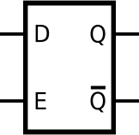



4 bit ALU
𝐒_{𝟑} 𝐒_{𝟐} 𝐒_{𝟏} 𝐒_{𝟎}
A[3:0] B[3:0]
4
0 0 0 0 (0)
0 0 0 1 (1)
0 0 1 0 (2)
0 0 1 1 (3)
0 1 0 0 (4)
0 1 0 1 (5)
0 1 1 0 (6)
0 1 1 1 (7)
1 0 0 0 (8)
1 0 0 1 (9)
AND
4
4
4
4
4
4
4
4
4
R[3]
4
OR
R[2]
zf
4
R[1]
4
XOR
R[0]
4
4
LEFT SHIFT
S[1:0]
4
R[3:0]
dzf
B[1:0]
4
2
RIGHT SHIFT
S[1:0]
sf
B[1:0]
2
4
ADD/SUB
4
𝑺𝒆𝒍
C
1
A[1:0]
2
dsf
B[1:0]
MUL
2
4
LEFT ROTATE
S[1:0]
4
B[1:0]
2
cf
dcf
4
RIGHT ROTATE
S[1:0]
4
B[1:0]
2
1 0 1 0 (10)
1 0 1 1 (11)
1 1 0 0 (12)
1 1 0 1 (13)
1 1 1 0 (14)
1 1 1 1 (15)
clk
4
NOT
4
CMP (SUB)
4
3 bit FLAG Register
(without selection line)
4
4
DIV
4

Slide 66
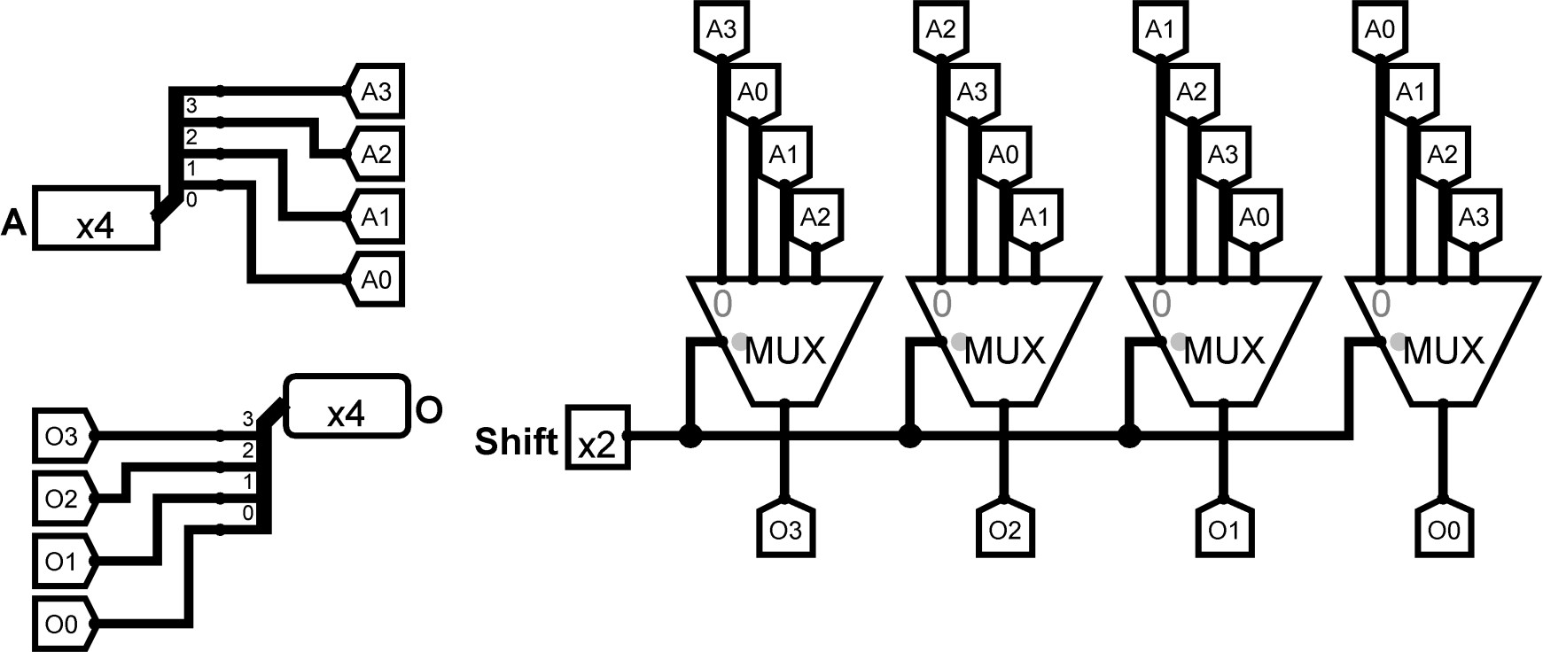
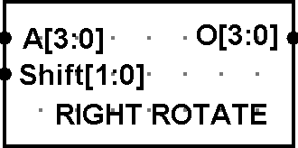
Example: ALU
Question: Design a 4-bit ALU that supports RIGHT ROTATE and DIV (Unsigned) operations.
Answer:
4-bit RIGHT ROTATE Circuit:
1 bit 4-to-1 MUX
Figure: 4-bit RIGHT
ROTATE Chip
Figure: 4-bit RIGHT ROTATE Circuit

Slide 67
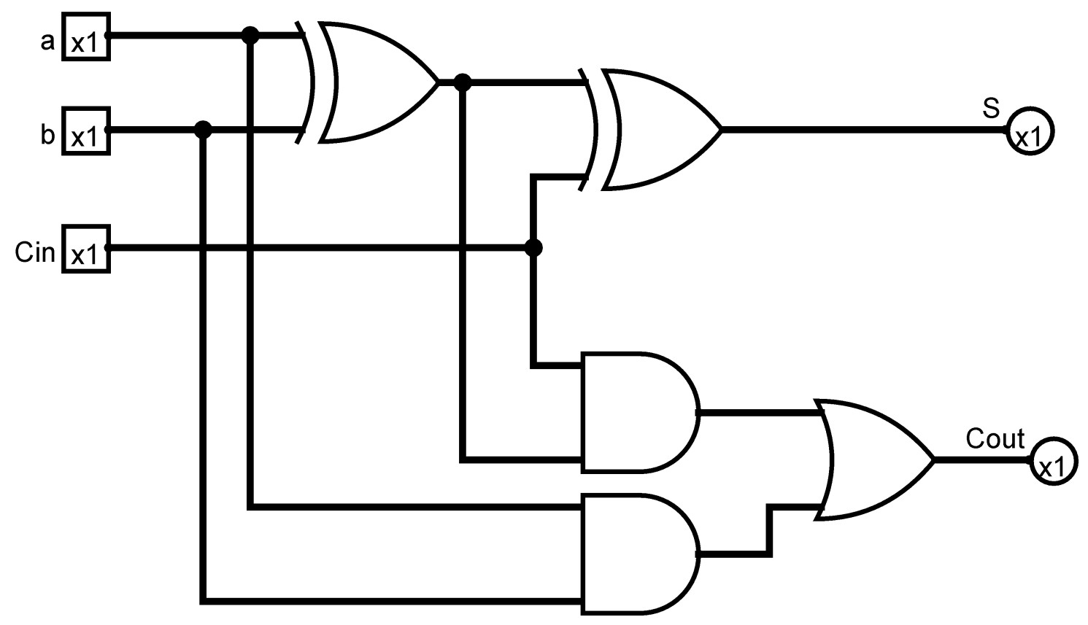
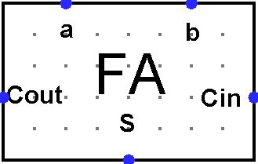
Example: ALU
4-bit DIV (Unsigned) Circuit:
Figure: 1-bit Full Adder
Chip
Figure: 1-bit Full Adder Circuit

Slide 68
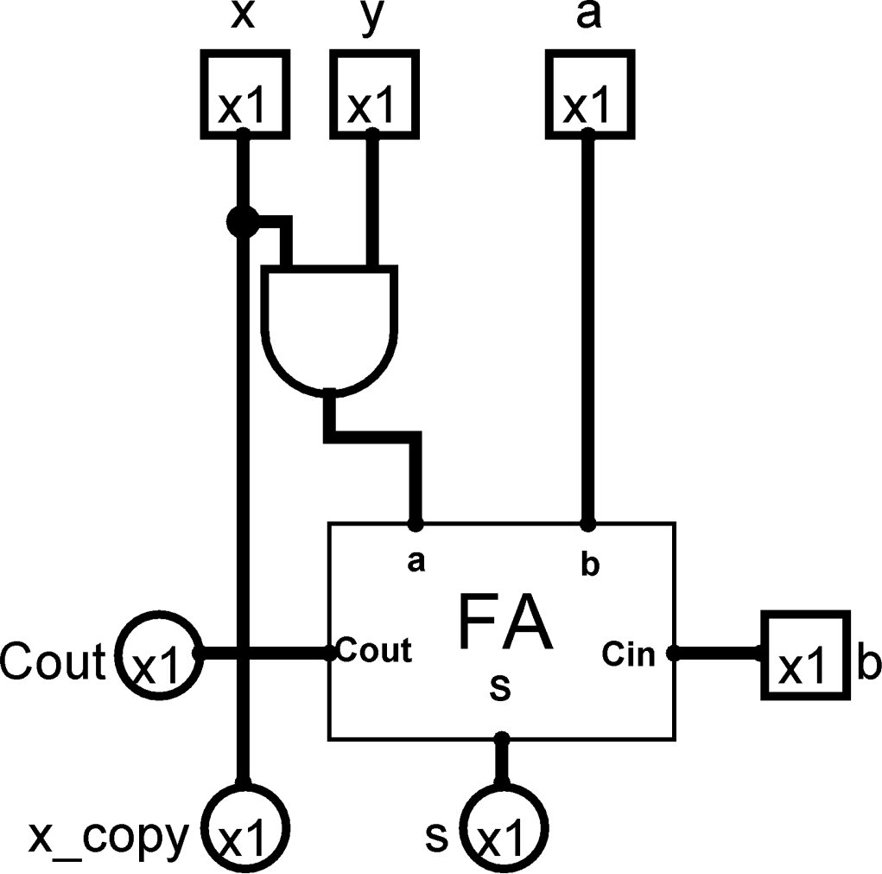
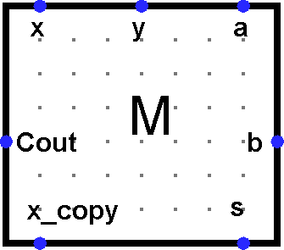
Example: ALU
4-bit DIV (Unsigned) Circuit:
Figure: Cell M (Divider Block) Chip
Figure: Cell M (Divider Block)

Slide 69
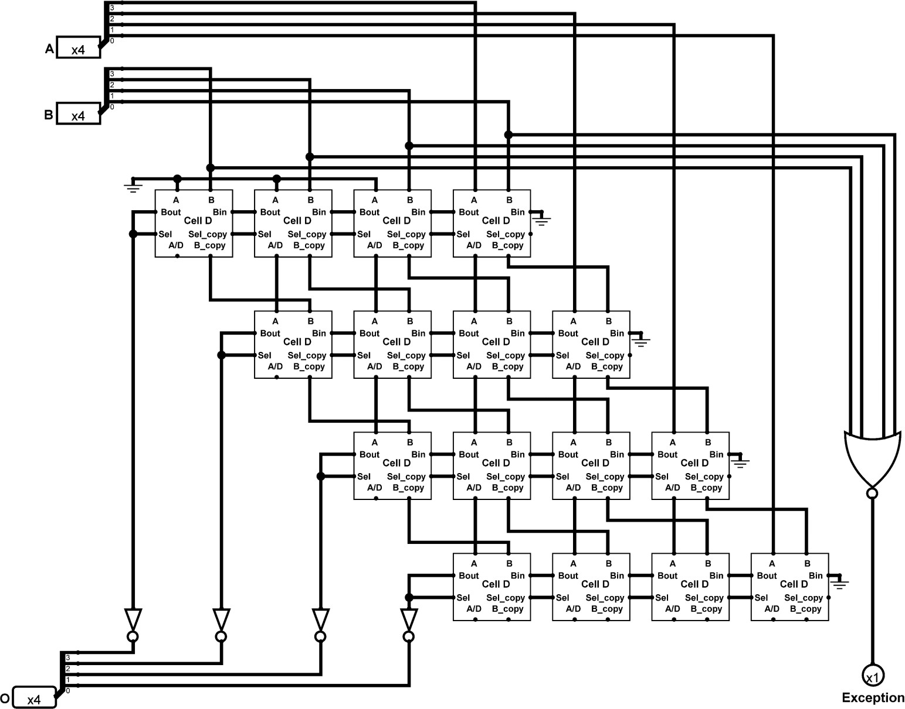
Example: ALU
4-bit DIV (Unsigned) Circuit:
Figure: 4-bit Unsigned Divider

Slide 70
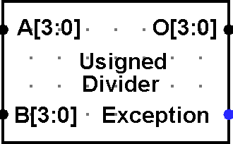
Example: ALU
4-bit DIV (Unsigned) Circuit:
Figure: 4-bit Unsigned Divider Chip

Slide 71
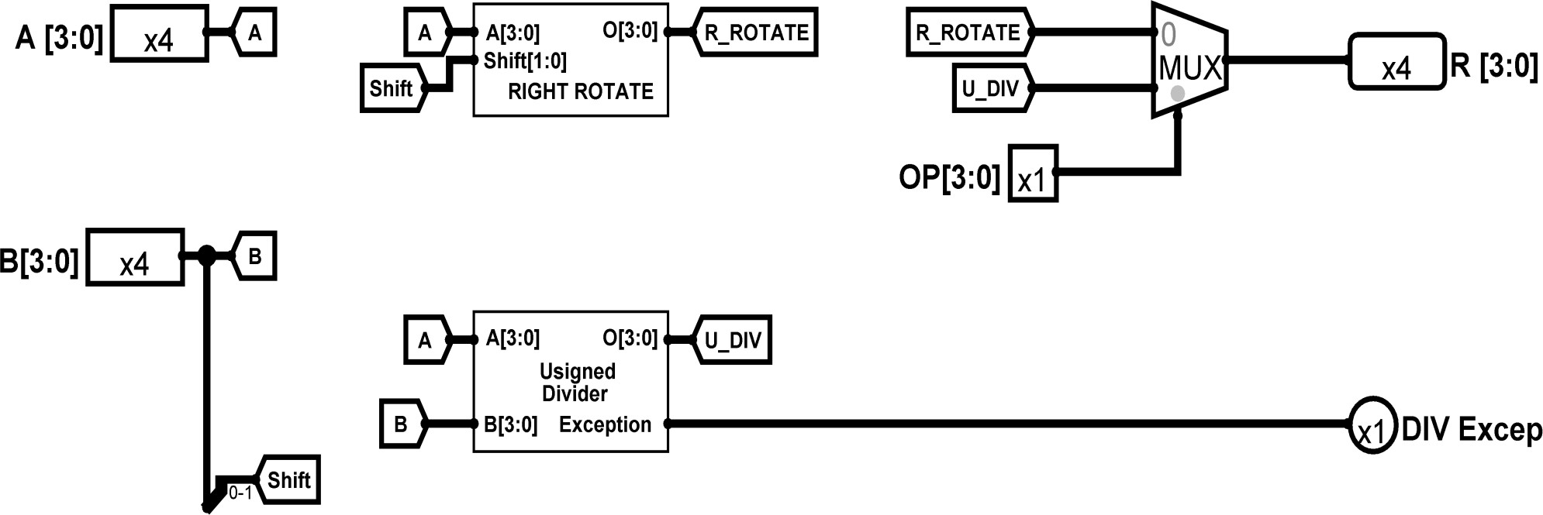
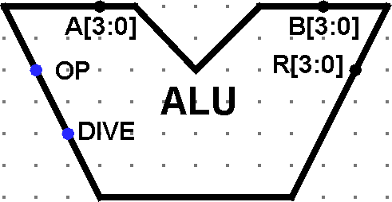
Example: ALU
4-bit ALU Circuit:
4 bit 2-to-1 MUX
Figure: 4-bit ALU Circuit that supports RIGHT ROTATE and DIV
Figure: 4-bit ALU Circuit Chip

Slide 72
Exercises
Draw/Design/Implement an 1-bit/2-bit/3-bit/4-bit/5-bit ALU that supports following operations:
ADD /
SUB /
MUL /
DIV /
LEFT SHIFT /
RIGHT SHIFT /
LEFT ROTATE /
RIGHT ROTATE /
AND /
OR /
XOR /
NOT / xiii.CMP

Slide 73
Thank You ☺

